Slide 1
Optimizing Search Results for Appliances
Data Poets

Slide 2

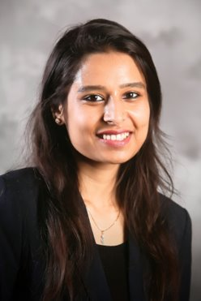


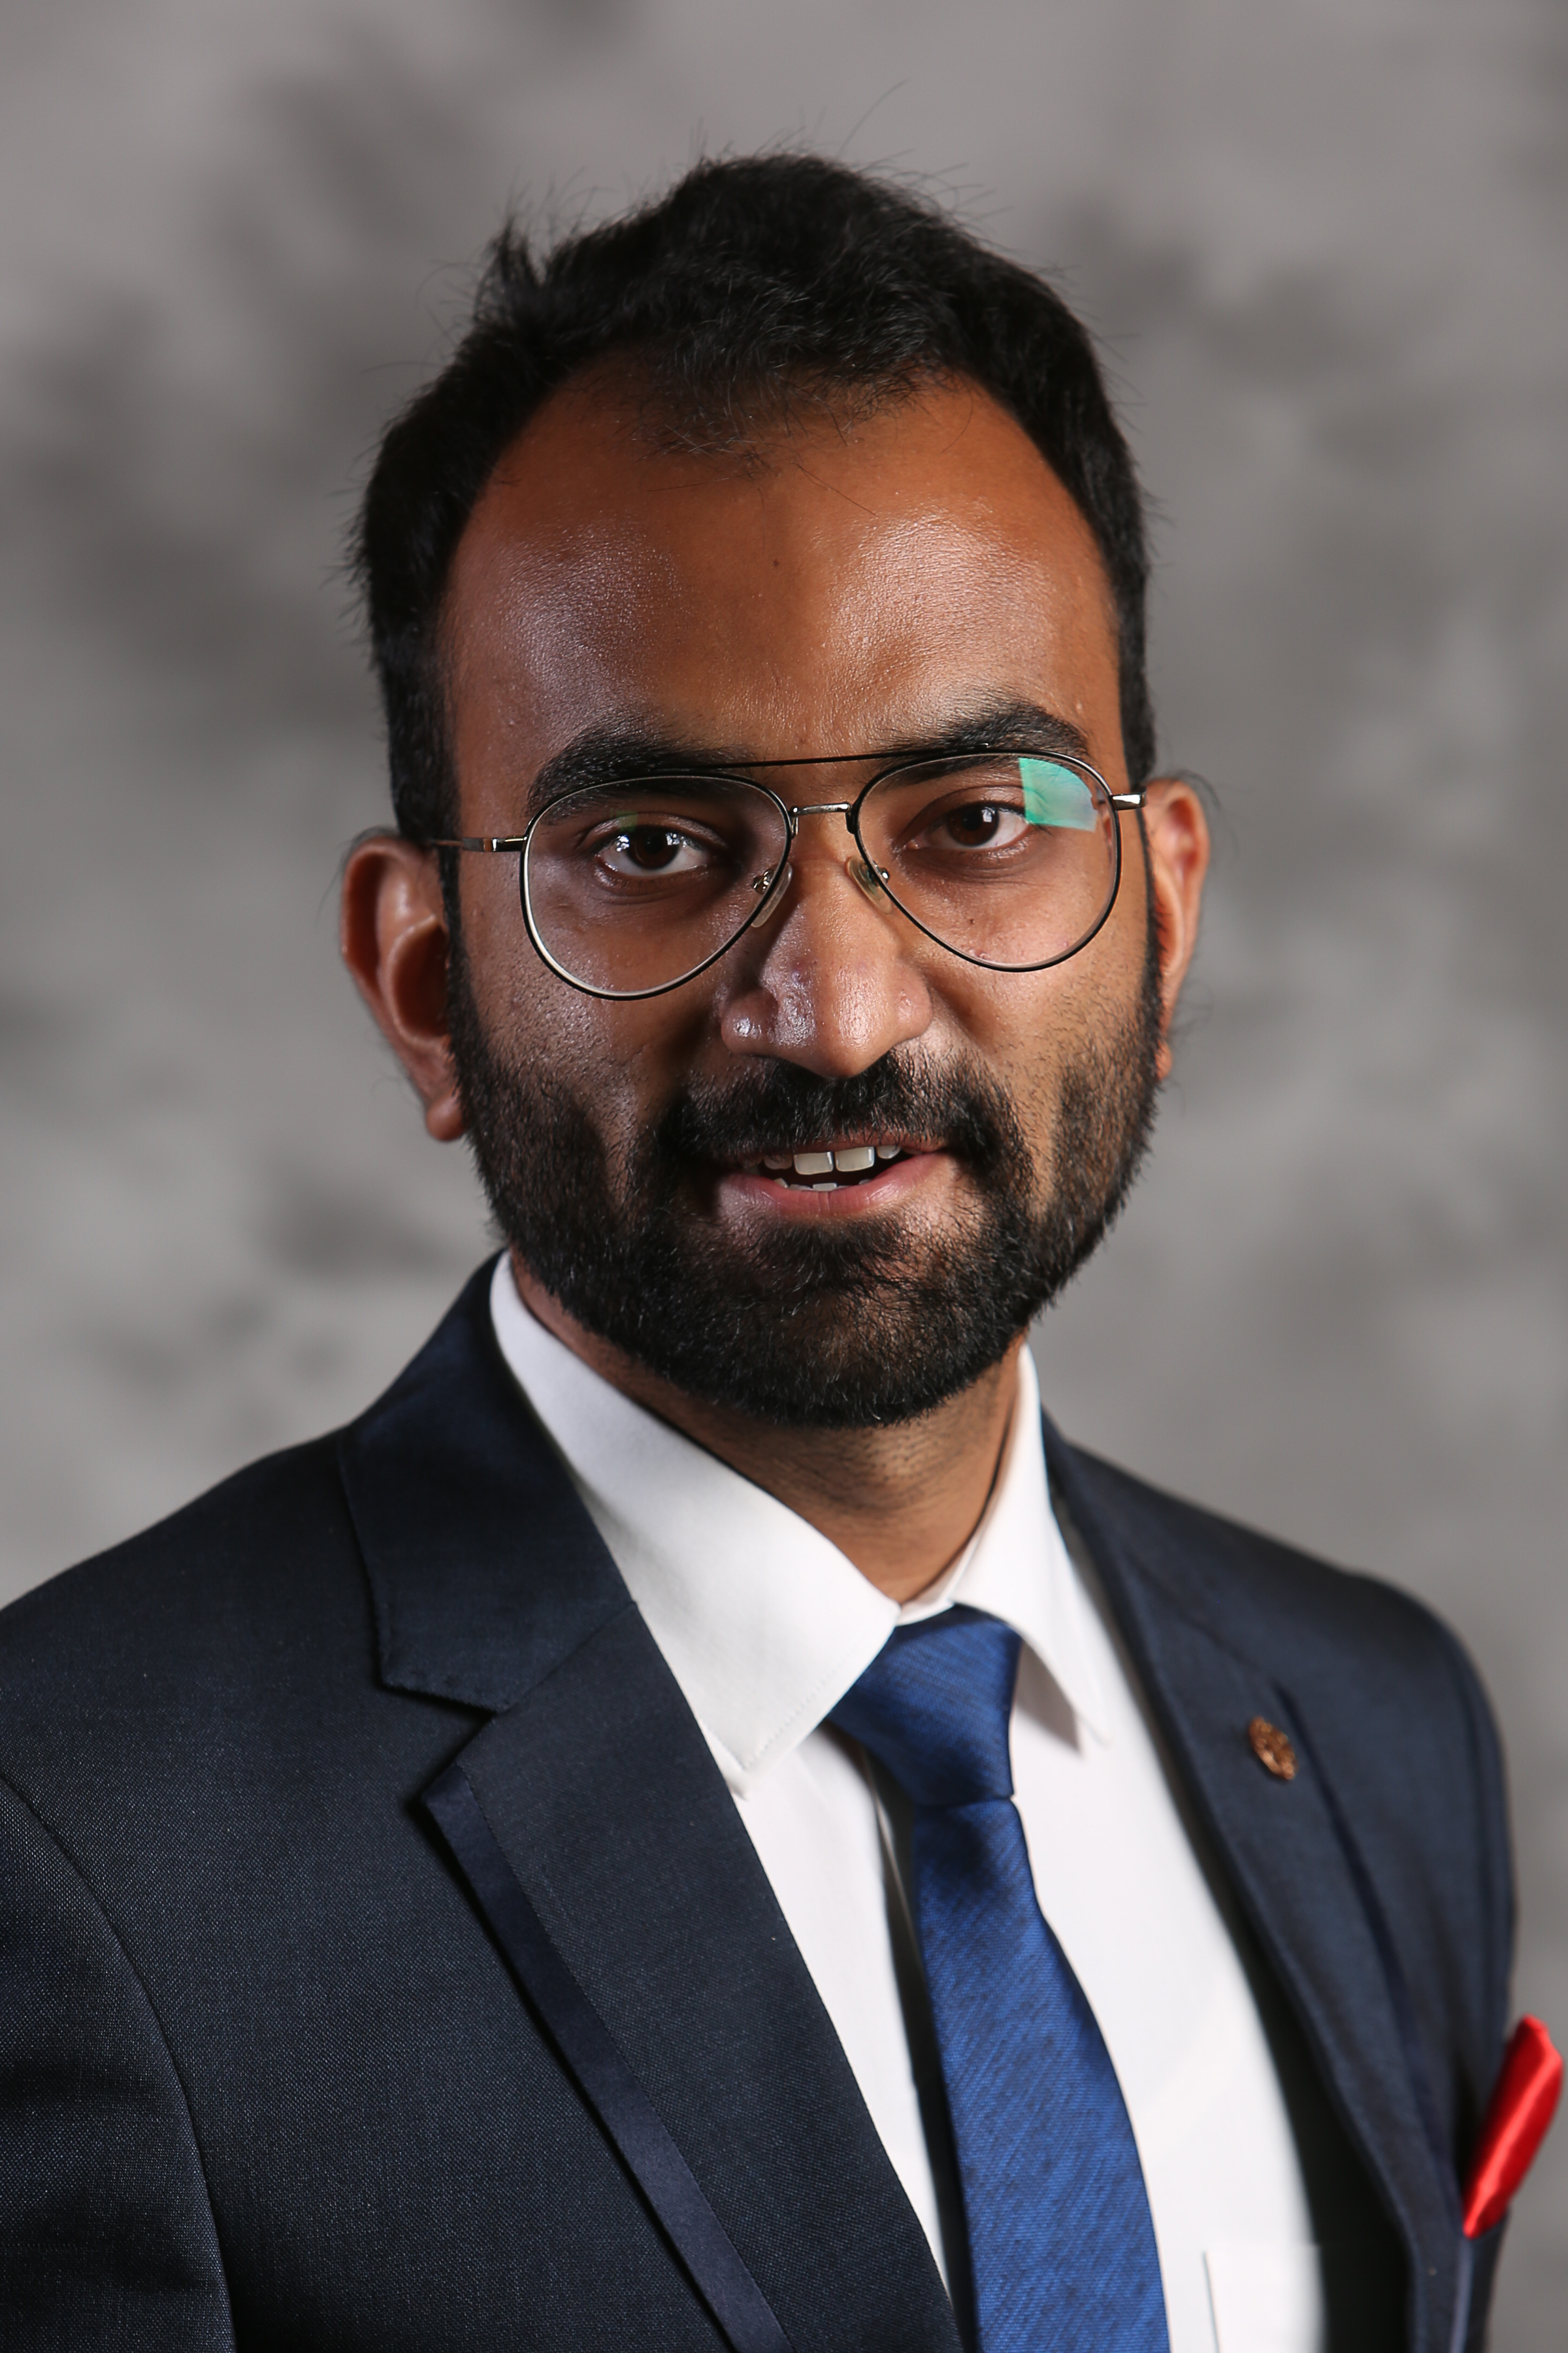
Our Team
Arpan Datta
Neha Gupta
Gokul Harindranath
Padmapriya Pannerselvam
Sagar Baronia

Slide 3
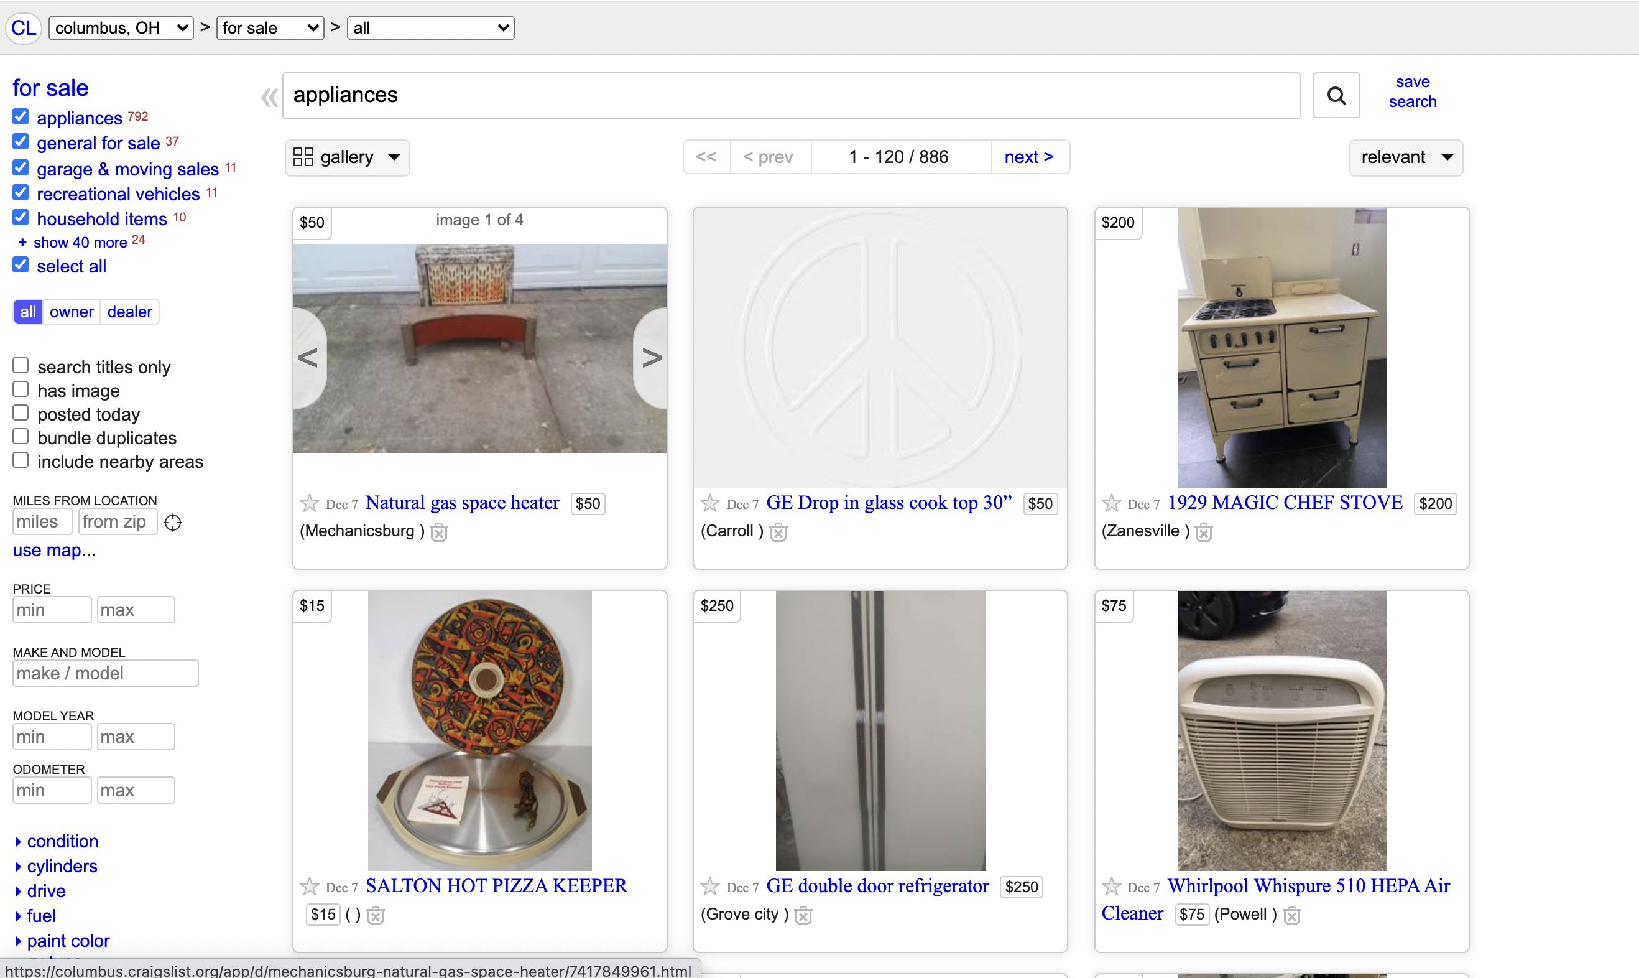
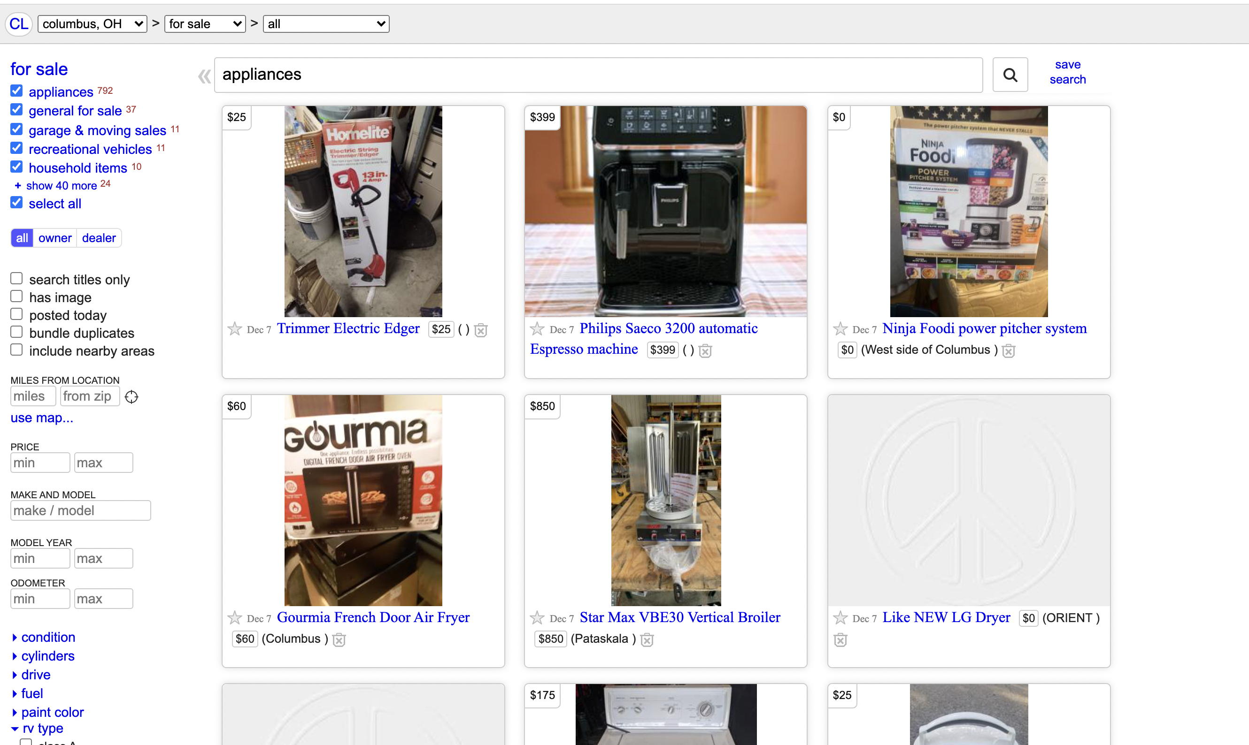
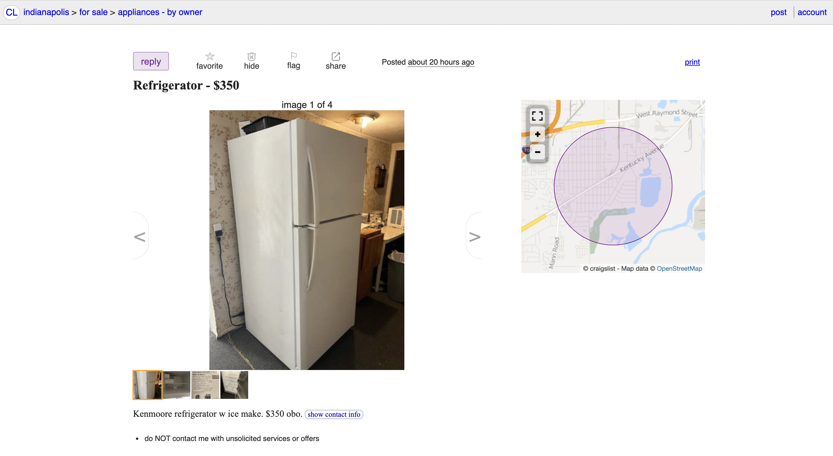
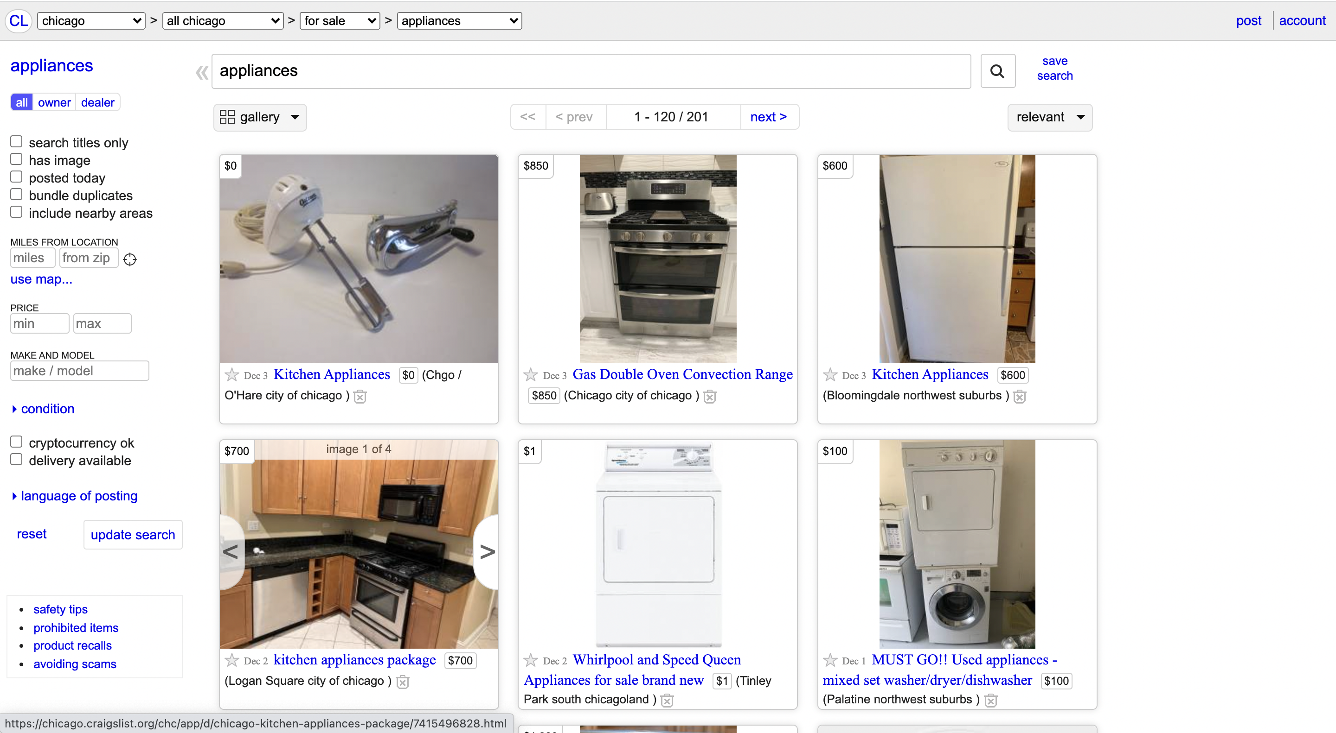

Slide 4


Slide 5
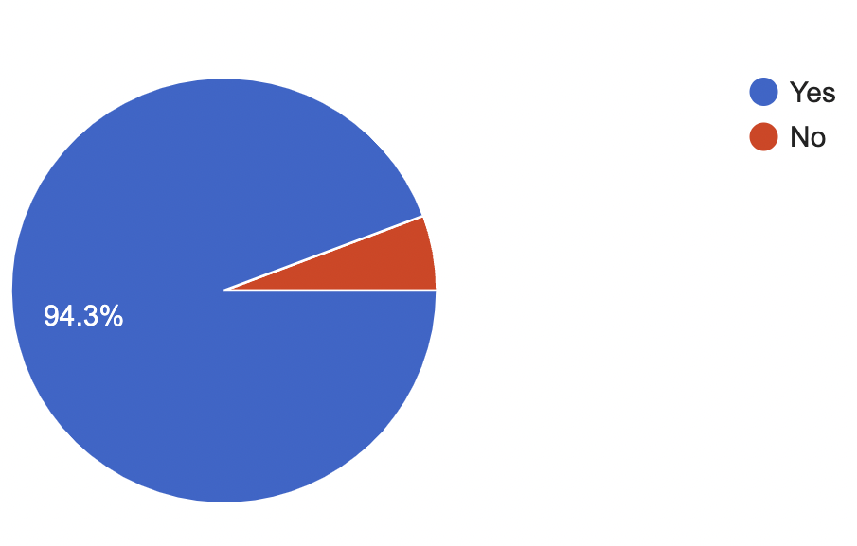
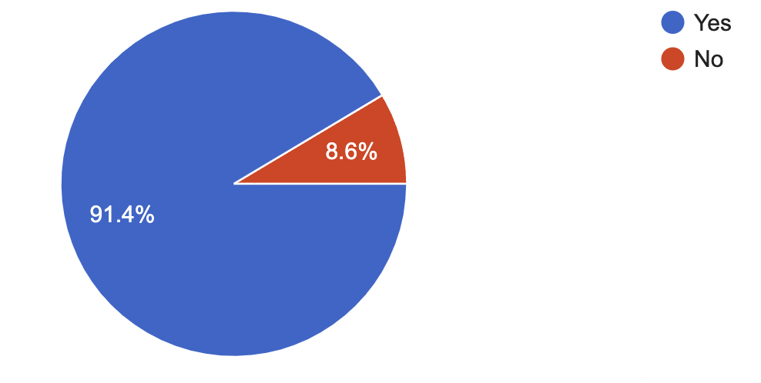
Creation of Sub-Category
Creation of Tags

Slide 6
Problem Statement
Where?
Sub-Category
Classification of Appliances Section
What?
Creation of Tags
How?
Notes:
Where is business problem
What is business problem
How are we doing it

Slide 7
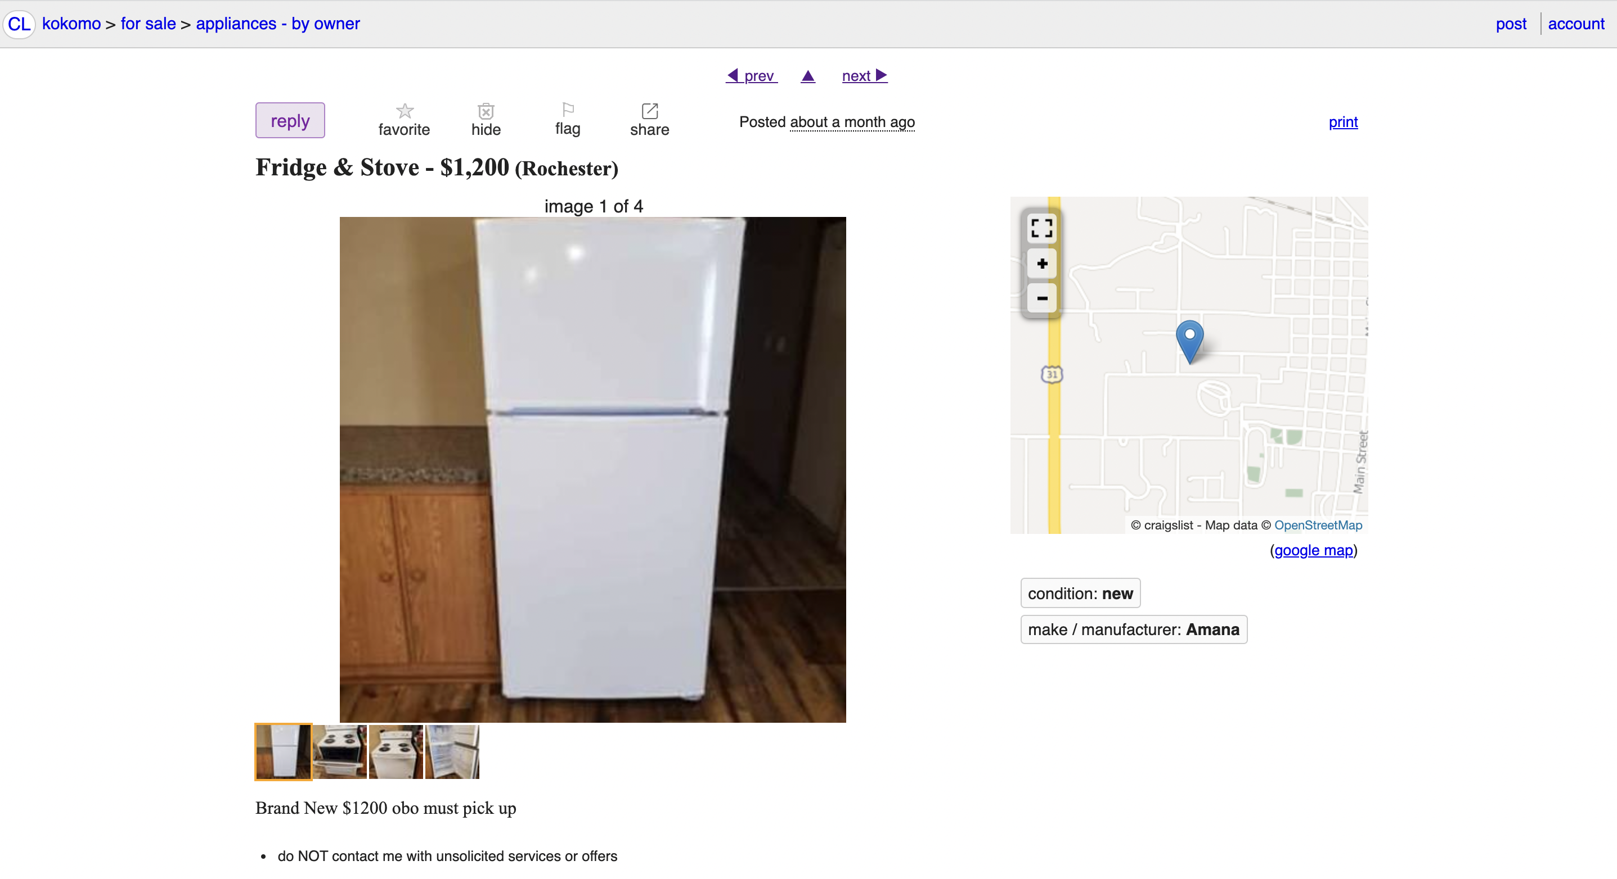
Proposed Solution

Slide 8


Process Flow
Image Analysis
Data
Preprocessing
Model
Assessment
Outcome
Problem Identification
Data
Collection
Model
Assessment
Outcome
Data
Analysis
Data
Preprocessing
Model
Selection
And
Prediction
Text Analysis

Slide 9
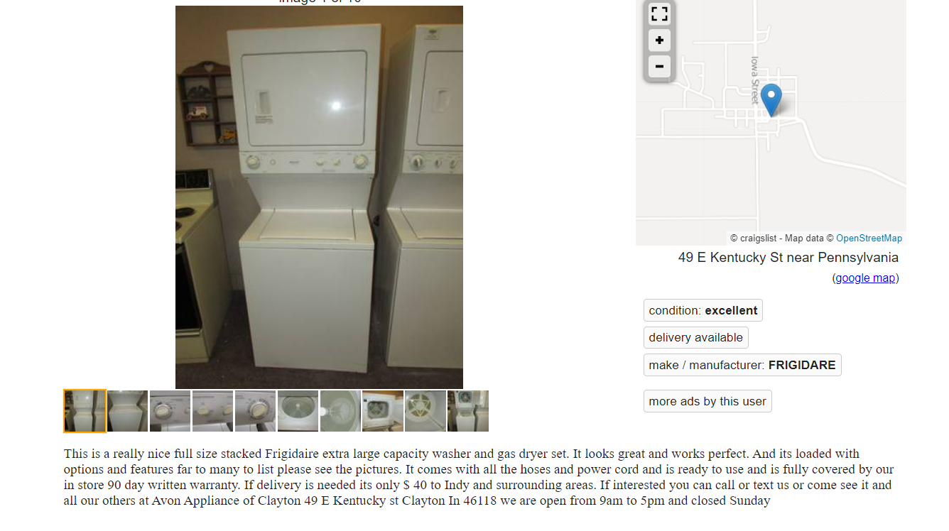







Data Collection
Description
Price
Title
Condition
Images
Description
Scraped data using xml parser
.csv file with ~1500 records
Images of appliances
Data
Collection
Data
Preprocessing
Model
Selection
Outcome

Slide 10
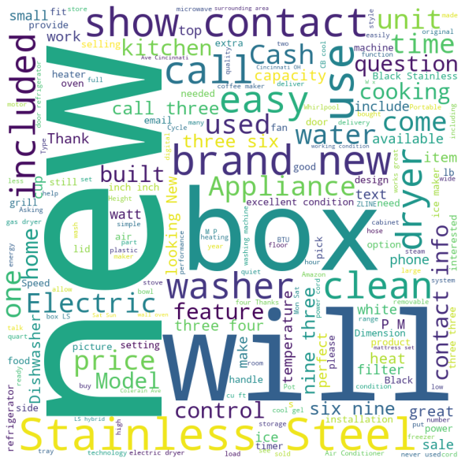
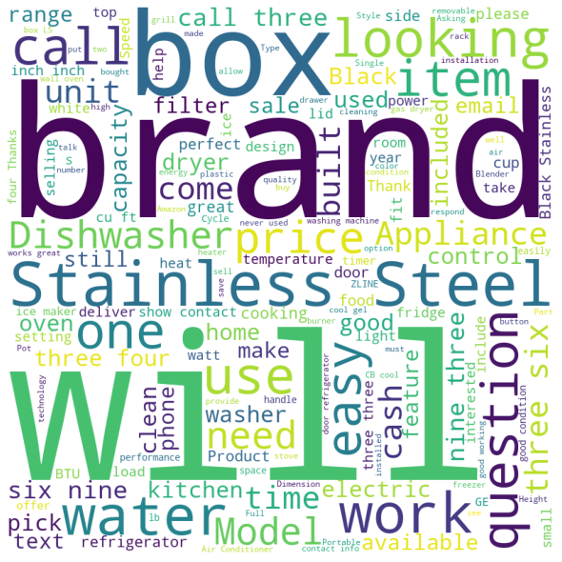
Data analysis
Excellent & New
Good, Like New & Fair
Model Selection
And Prediction
Model
Assessment
Outcome
Data
Analysis
Data
Preprocessing

Slide 11


Model Assessment
Accuracy
Clean Stopwords
Created a dictionary of stop words including special characters
Basic Preprocessing
Naïve Bayes (Multinomial)
59.37%
Gaussian Naïve Bayes
62.25%
Word Embedding
67.5%
Ridge Classifier
68%
Used count vectorization
Vectorization
Random Forest
70%
Model Selection
And Prediction
Model
Assessment
Outcome
Data
Analysis
Data
Preprocessing

Slide 12




Data Preprocessing
Used count vectorization
Used Crawl-300d-2M.vec
Tried both compound and positive sentiment scores
Vectorization
Embedding
Clean Stopwords
Length of desc, No of words, Category,
Presence of digit
Sentiment scoring
Created a dictionary of stop words including special characters
Create new variables
Model Selection
And Prediction
Model
Assessment
Outcome
Data
Analysis
Data
Preprocessing

Slide 13
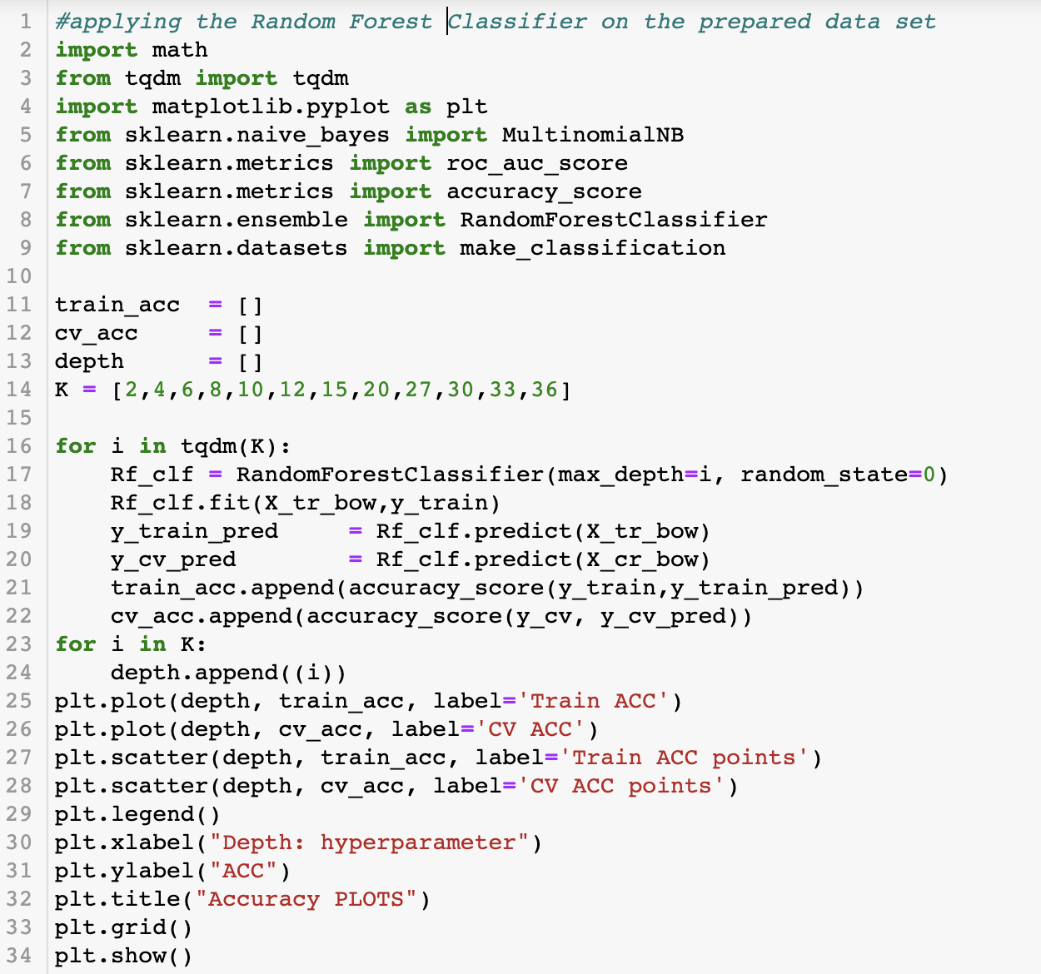
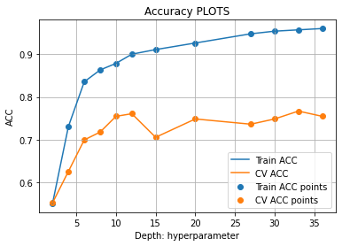
Model Selection and Prediction
Best model: 77% Accuracy
Model Selection
And Prediction
Model
Assessment
Outcome
Data
Analysis
Data
Preprocessing

Slide 14
Outcome
Used once for a party. It’s in brand new condition showing no wear at all. Pickup near Harlem & Devon, 60631 zip
Category 1
It may have been used. Looks new. It's presently $420 plus tax everywhere.
Category 2
Model Selection
And Prediction
Model
Assessment
Outcome
Data
Analysis
Data
Preprocessing

Slide 15
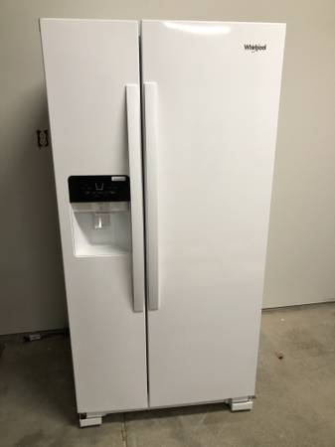
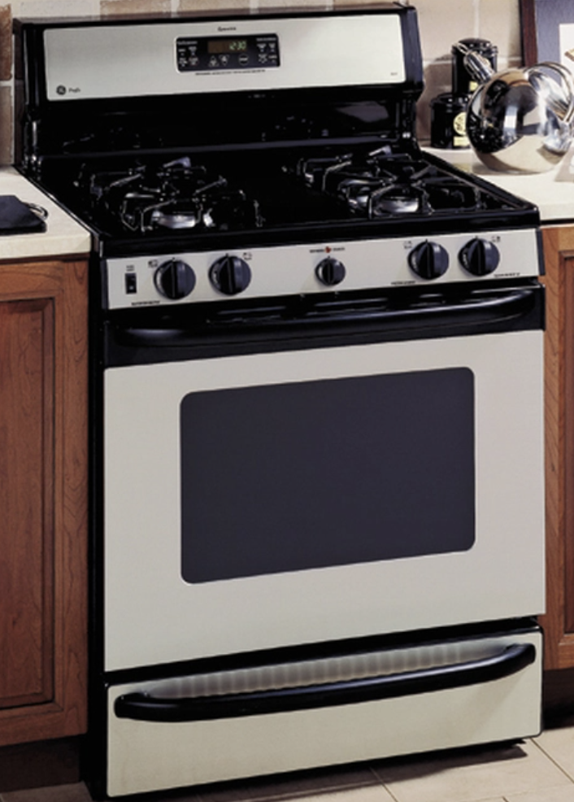
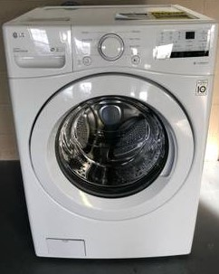
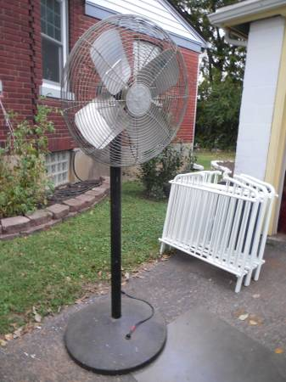
Image Classification
Refrigerator
Stove oven
Washer Dryer
Fan

Slide 16
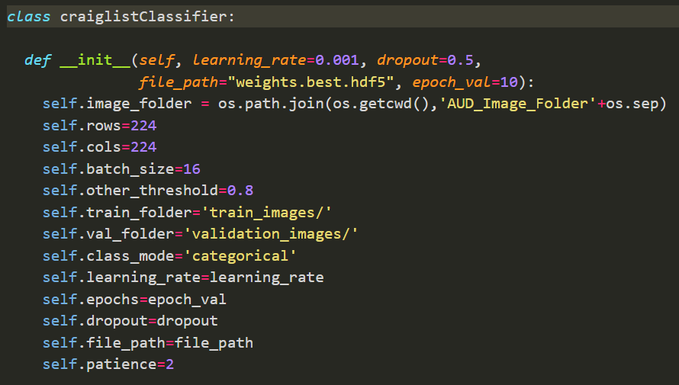
Model Hyperparameters

Slide 17
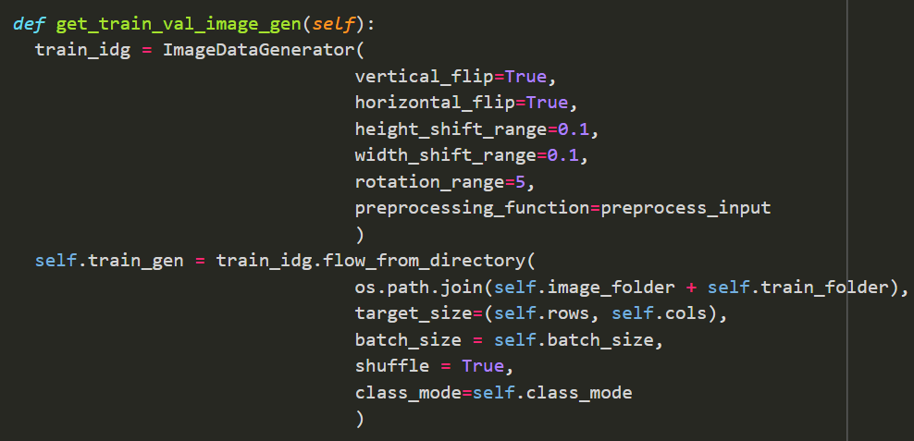
Image Augmentation

Slide 18
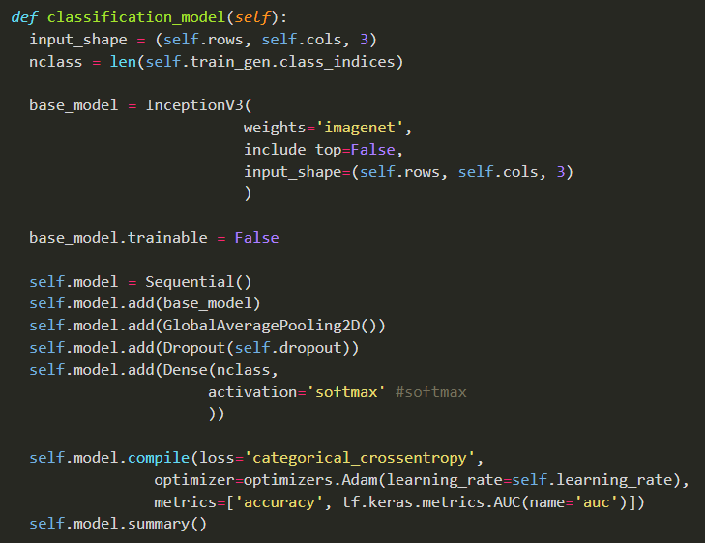
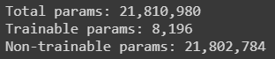
Model

Slide 19
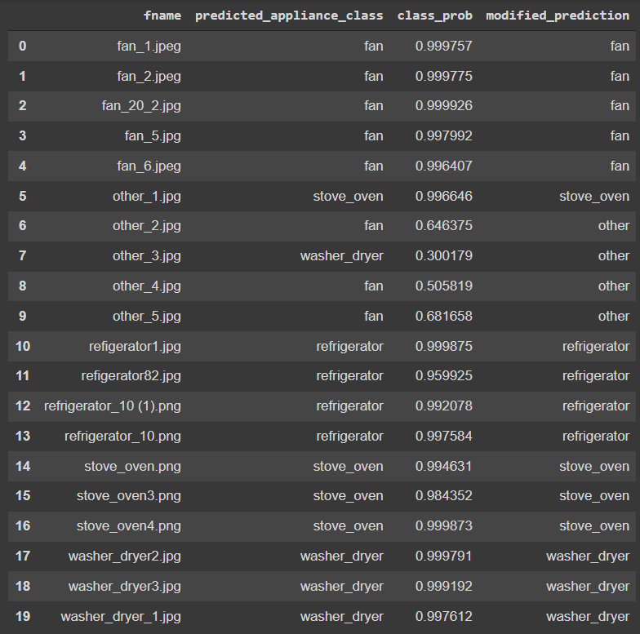
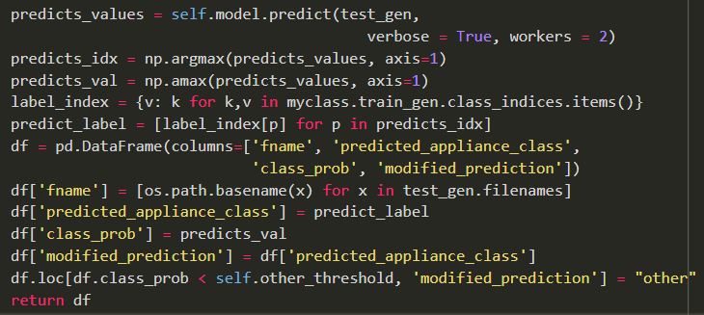
Test Images

Slide 20
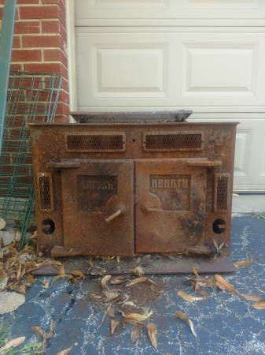
Incorrectly classified as stove oven

Slide 21
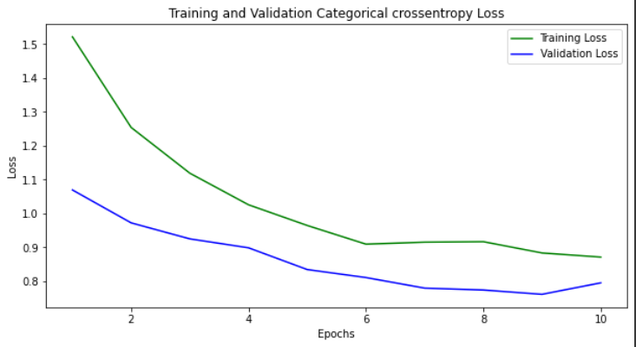
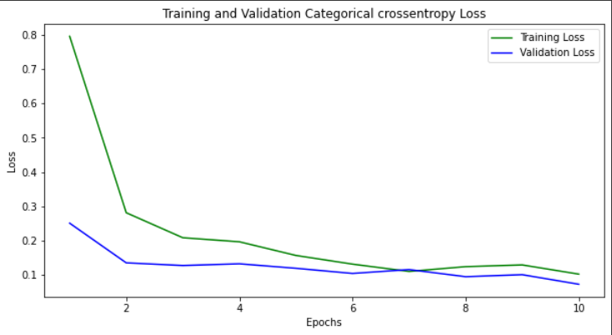
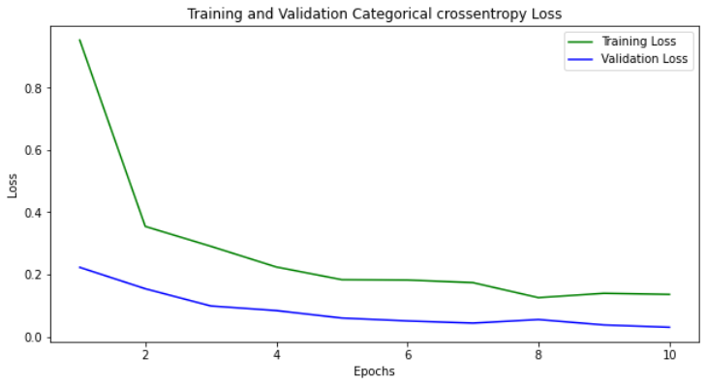
Model Comparison
91.42%
99.92%
100%
ResNet50
Xception
Inception-v3
85%
Saturn
Saturn is a gas giant and has several rings

Slide 22


Slide 23



Business Impact
Buyer
Seller
Craigslist
Before
No easy filtering for products
No price reference point for a seller
Ad visibility low due to unorganized formatting
Saves time
Better position to negotiate
Gets a competitive price
Product sells faster
More traffic on the platform
Positive network effect
After

Slide 24
Future Scope
Scaling to other sections on Craigslist
Implementing Fast Text
Ex: stupedofantabulouslyfantastic
Condition tagging using image processing

Slide 25


Thank You

